Slide 1
Understanding the yield gap between the genetic potential and achievable yields.
David Clay
Interview for Systems Agronomist

Slide 2
Background
BS from University of Wisconsin
MS from University of Idaho
PhD. From the University of Minnesota
Professor at SDSU
  Teaching and research appointment
Director of the SD Drought Tolerance Center
  Build teams and link the basic and applied sciences

Slide 3
Background
Past chairs of the ASA Precision Agricultural Systems community and Agricultural Systems Division,
Technical Editor AJ (Weeds and Soils),
Served on numerous grant panels,
Serving on the SD EPA-319 task force,
Editor SD Corn, Soybean, and Wheat BMP manuals,
Represented the ASA/SSSA at a AAAS sponsored congressional briefing on climate change,
Help write the ASA/SSSA/CSA white paper on climate change.

Slide 4
Awards
Awarded the Weed Science Society 2013 Paper of the Year,
2009 PrecisionAG Award of Excellence, Education/research Award,
Fellow American Society of Agronomy, 2007,
Awarded SD Sigma Xi Presidents Award for Service, 2006,
Awarded USDA-ARS Collaboration Award, April 20, 2006,
Awarded SDSU F.O. Butler Award for Excellence in Research, 2004,
Awarded the Deans Award for Teamwork, 2004,
Awarded the Gamma Delta Research Award, 1996,
Awarded the Deans Award for Excellence, 1994.
81 invited presentations since 1999;
111 funded grants providing over 20 million dollars to SDSU;
ASA Certification of Extension Excellence: Corn BMP,
ASA Certificate of Extension Excellence: Wheat BMP.
CRC press, GIS Applications in Agronomy Identified as Best Seller.

Slide 5
Previous mentors at Minnesota
Have stressed that research and outreach programs should have deliverables with various timelines,
  1 year (current extension)
  5 years (upcoming extension)
  10-20 years (extension for the future)
Our group has built our success on this approach.

Slide 6
Extension or teaching products: GIS/mathematics
Site-Specific Management Guideline. 1999. Clay, D.E. et al. (ed.). Potash and Phosphate Institute. Available at http://www.ppi-far.org/ssmg.
GIS Applications in Agriculture. 2007. Pierce F.J. and D. Clay (eds). CRC Press, Taylor and Francis, New York, New York. http://www.crcpress.com/product/isbn/0849375266
GIS Applications in Agriculture: Nutrient Management for Improved Energy Efficiency. Clay and Shanahan (eds). 2011. Available at http://www.crcpress.com/product/isbn/0849375266
Mathematics and Science for Agronomists and Soil Scientists. 2011. Clay, D.E., S.A. Clay, C.G. Carlson, and S. Murrell. International Plant Nutrition Institute, available at http://ppi-store.stores.yahoo.net/maandcaforag.html
Mathematics and Science for Agronomists and Soil Scientists: Metric Version, 2012. Clay, D.E., S.A. Clay, C.G. Carlson, and S. Murrell. International Plant Nutrition Institute, available at http://ppi-store.stores.yahoo.net/maandcaforag.html

Slide 7
Extension and outreach
A Step-by-Step Field Analysis. 2008. Logsdon, S., D.E. Clay, D. Moore, and T. Tsegaye (eds). American Society of Agronomy. Madison, WI. Available at https://portal.sciencesocieties.org/Resources/Files/downloads/pdf/B60915.pdf
South Dakota Corn Best Management Practices. 2009. Clay, D.E., S.A. Clay, and K. Reistma (eds). SDSU, Brookings, SD. Available at http://pubstorage.sdstate.edu/AgBio_Publications/articles/EC929.pdf. Soil Science:
IGROW Wheat: Best Management Practices for Wheat Production. 2012. Clay D.E., C.G. Carlson, and K. Dalsted (eds).
IGROW Soybeans: Best Management Practices for Soybean Production. 2013. Clay, D.E., S.A. Clay, C.G. Carlson, C. Hay, L. Wagner, and D. Deneke (eds.).
  60 chapters with over 50 authors

Slide 8
Current book activities
Serving on the tri-societies book committee,
  Assisting in the development of manual on precision conservation (Jorge Delgado)
  Precision Conservation: Developing a Carbon Budget and Calculating the Mineralization Rate Constants
Revision the South Dakota Corn Best Management Practices manual
  Just starting
Starting a new book on
  Practical Mathematics for Precision Farming
  Just starting

Slide 9
Stuff I will not talk about
The use of stable isotopes to improve our understanding of plant stress.
Using non-isotopic and isotopic techniques to calculate soil carbon turnover.
  Crop systems
  Range systems
Remote sensing,
Precision farming,
Determining plant population algorithms,
Opportunities to increase yields in the future,
Root growth,
Soil sampling techniques,
Life cycle analysis,
Quantifying impacts of outreach activities.

Slide 10
Future needs
The world is challenged by multiple problems including:
Increasing food production with less available resources and increasing the production potential of marginal lands.
We are very concerned about
Gazing and CRP → row crop production
We believe that increasing sustainable food production on prime and marginal lands can only be accomplished by broad-scale investments in agriculture.

Slide 11
Teams with a range of expertise are needed
Agronomists,
Soil Scientists,
Range Scientists,
Climatologists,
Ecologists,
Wildlife experts,
Livestock specialists,
Engineers,
Computer programmers,
GIS experts,
Economists,
Journalists,
Book publishers,
Extension specialists,
Teaching specialists,
Commodity groups and farmers,
Pest scientists,
Molecular biologists,
Mathematicians,
Economists and Social Scientists

Slide 12
Problem: climate is the tipping point that converts sustainable practices to non-sustainable practices
The world produced 2,241 million tons of grain in 2012, down 75 million tons or 3 percent from the 2011 record harvest.
  Droughts in 2012 occurred in the United States and Russia, Kazakhstan, Ukraine, and Australia.
  Global grain consumption fell significantly for the first time since 1995,
  Overall consumption exceeded production.
Many critical resources (land and P) are in short supply.
Many pests are becoming better adapted to our control approaches.
Earth Policy Institute (http://www.earth-policy.org/indicators/C54

Slide 13
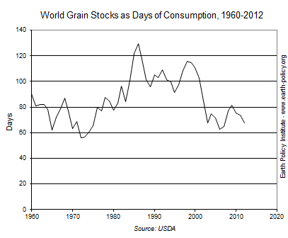
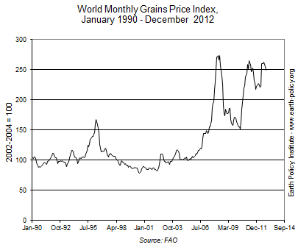
World food markets

Slide 14
Increasing food production
Rely on the large seed companies to produce better seed;
Or
Invest in agricultural research that will lead to the adoption of sustainable practices and higher yields?

Slide 15
Production benchmarks. Are NASS yields a good benchmark for corn, soybeans, and wheat?

Slide 16
Good benchmarks are critical for assessing current status.
Can we improve food security and resilience against extreme climatic events by narrowing the yield gap on prime farm land?

Slide 17
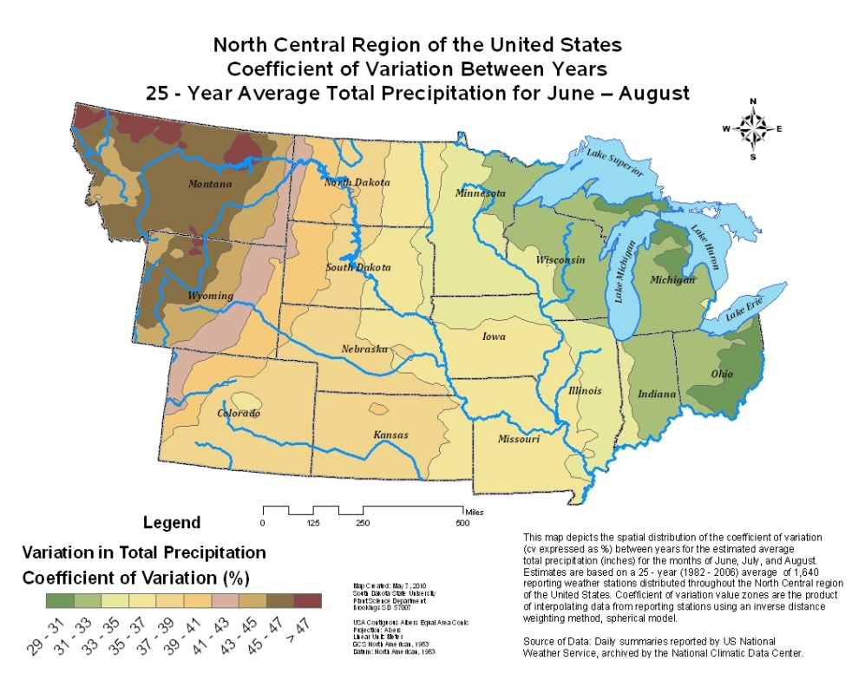
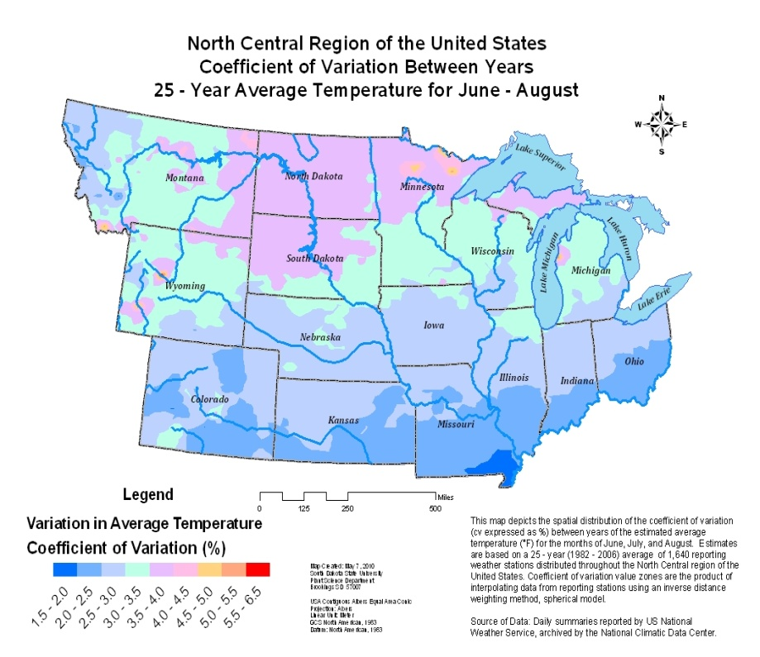
The problem we have been working on is how to improve food security in a highly variable climate.
Climate variability can change a sustainable system to a non-sustainable system
Our team has been looking at this from both range and crop perspectives.

Slide 18
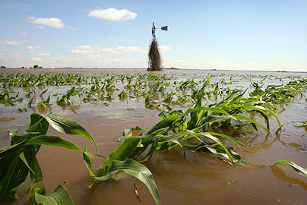
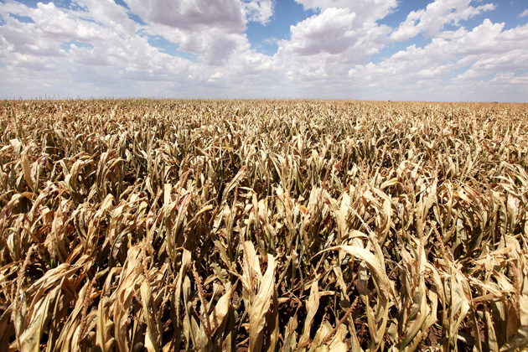
Food security
Go from drought to flood very quickly

Slide 19
Changes in yield and
profitability are increasing
the amount of corn and soybeans seeded at the expense of minor crops (barley, oats, peas, ect).
 | Return/investment ratio
Corn | 1.24
Soybean | 1.34
Wheat | 1.07

Slide 20
Can yield increases continue? And is the increase in the number of hectare to row crops sustainable?
Causes for the corn yield increase
Genetics
Management

Slide 21
We know that increasing yields takes genetics and management
Man. +
genetics
Genetics
alone
(Hammer et al., 2009; Crop Sci. 49:299-312)

Slide 22

Plant population why?
Integrating basic and applied sciences.

Slide 23
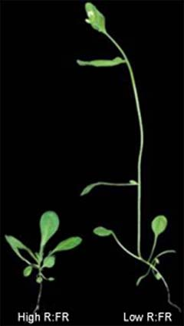
Plant crowding due to high planting density or weed competition
Often results in shade avoidance response
  Taller, etiolated plants
  Plants with smaller leaves
  Leaves with less chlorophyll
  Less flower production

Slide 24
Objective
Compare plants grown at normal and high densities
  Gene regulation
  Stable isotope discrimination (¹³C/¹²C and ¹⁵N/¹⁴N) techniques

Slide 25
Materials and methods
Study conducted at Aurora, SD using an adapted corn hybrid on a silty clay loam soil,
Corn planted at,
  74,500 plants/ha (normal population),
  149,000 plants/ha (2x population),
Irrigated or not-irrigated,
0 or 228 kg N/ha,
60% shade treatment added to a normal population at V6 stage of corn growth,
RCB design with 4 replications.

Slide 26
Sampling
At V12/V14 stage of corn growth
  Uppermost leaf samples taken for micro-array analysis to determine genes that were differentially expressed,
  Chlorophyll content using SPAD meter,
  Plant height.
At harvest,
  Grain yield,
    N content, isotope discrimination,
  Above ground biomass.

Slide 27
Shade impacts
 | Yield (g/plant) | Yield (kg/ha) | C13 isotopic dis. | Relative chloro.
0 shade | 158 | 11,800 | 3.35 | 0.83
60% shade | 81 | 6,000 | 3.69 | 0.84
Spad meter of the most recently expanded leaf.
Leaf samples collected at V12, Topmost fully expanded leaf,
frozen in liquid N until we conducted the analysis.

Slide 28
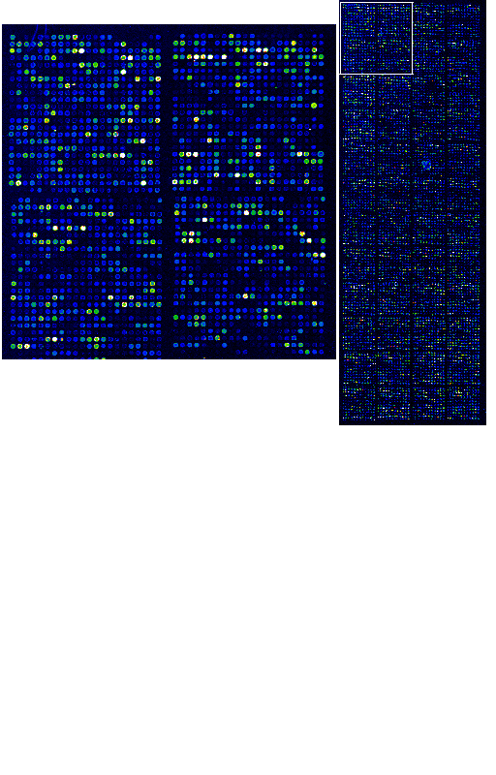
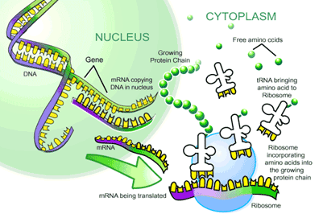
Extract RNA from control and treated plants,
30 ug RNA used to prepare labeled cDNA,
  Attach a green die to treated and red die to control
Hybridized to the 15,680 element SAM 1.2 Maize microarray
Blue-(red and green) similar concentration.
red means treated is up-regulated
green means control is up-regulated

Slide 29
Shade impacts on gene expression at V12
12 genes up-regulated in shade
  2 genes involved in amino acid metabolism (phosphogycerate dehydrogenase; serine carboypeptidase)
  2 genes involved in carbon metabolism (pyruvate orthophosphate dikinase PPDK)
  5 genes involved in drought stress
  2 genes involved in light reactions
  1 gene involved in protein stability

Slide 30
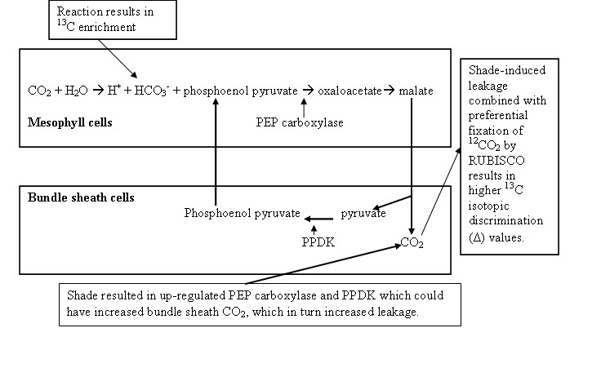

Slide 31
Population level impacts on corn growth
Averaged over N rate
 | Population | Kg/ha | g/plant | Chloro | C13
Dry-land | 1X | 11,000 | 147 | 0.79 | 3.39
 | 2X | 12,900 | 86 | 0.72 | 3.31
Irrigated | 1X | 12,800 | 171 | 0.79 | 3.23
 | 2X | 13,400 | 90 | 0.70 | 3.10

Slide 32
Genes differentially expressed at V12 (p<0.05)
75,000 vs 149,000 vs shade
  477 differentially expressed genes between the 2X and 60% shade when compared with the 1X treatment.
  The shade and 2X treatments had different responses to “competition”.

Slide 33
Net result of higher plant population
In the 2X treatment, plants grew smaller because photosynthesis was down regulated.
Per plant yield reductions in 2X population could not be attributed to competition for water, nutrients, or light.
Velvet leaf had the opposite results

Slide 34
Implications
Plants grown under high population and shade had large differences in the expression of carbon metabolism genes, although yield per plant was identical.
In shade, the up regulation of PEP carboxylase and Pyruvate orthrophosphte dikianse led to more CO₂ leakage from bundle sheath cells.
The linkage of molecular and stable isotopic techniques provide tools needed to develop answers to unknown questions.
  Our goal is to use data to mechanistically and mathematically define the relationship between yield and population, which will then be integrated into a APPs.

Slide 35
Has water use efficiency changed?
Both Monsanto and Pioneer have reported that water use efficiency has improved.
We looked at the published studies on water use efficiency
Grain yield/ET

Slide 36
Why were yields increased with increasing population?
Relationship between year of published research and water use efficiency in studies conducted across the US Great Plains.
Based on Musick and Dusek (1980), Eck (1984), Unger (1986), Howell et al., 1989), Steiner et al. (1991), Howell et al. (1995),
Hattendorf et al., 1988, Lamm et al., 1991, Hillel and Guron (1973), Steweart et al. (1975), Hanks et al. (1978, Stegman (1982),
Payero et al. (2009), Trooien et al. (1999), Kim et al. (2008), Monsanto (2010), and Pioneer (2009).

Slide 37
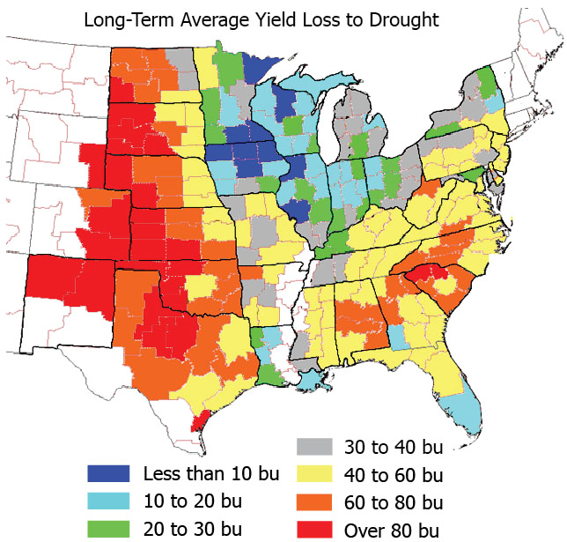
Implications
http://www.pioneer.com/CMRoot/Pioneer/US/agronomy/
Cropfocus/pdf/corn_drought_stress_tolerance.pdf

Slide 38
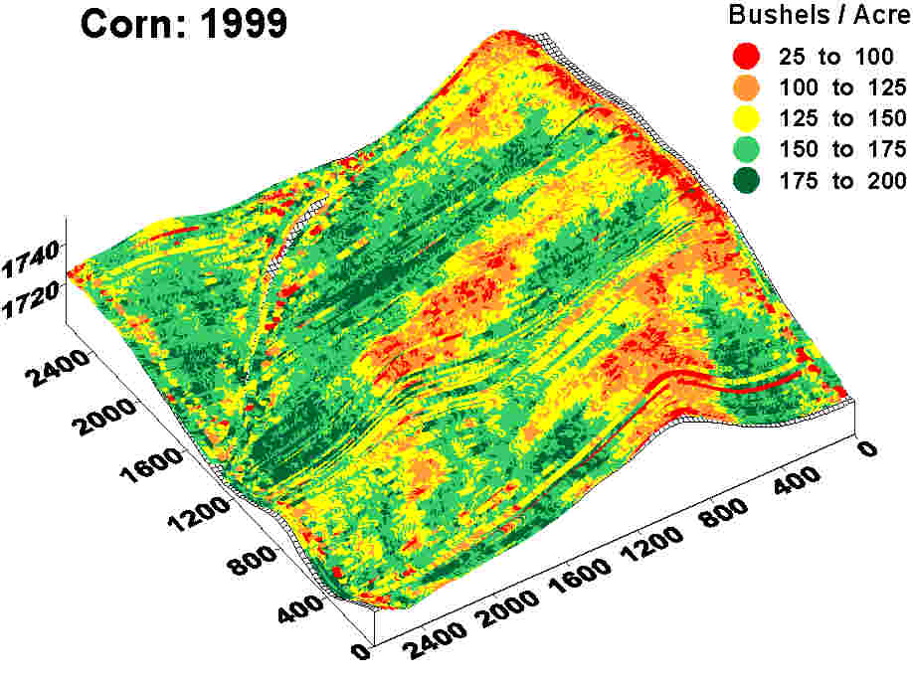
What happens across landscapes?

Slide 39
Does differential water stress impact pest and nutrient management?

Slide 40
Creating new knowledge through the creation of new tolls: Integrating basic and applied sciences.

Slide 41
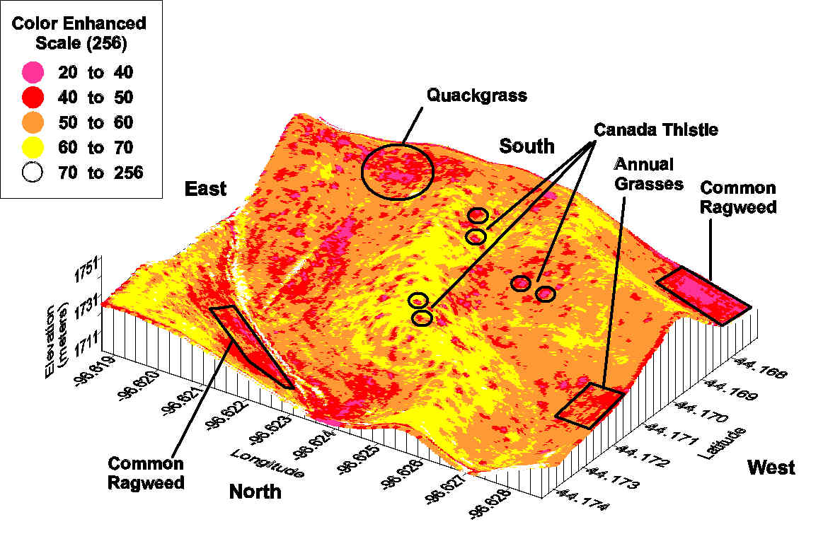
Mosaic of habitats that provide conditions favorable one species over another.
Are pests taking advantage of differential crop responses?
Does corn respond differently at different locations?

Slide 42

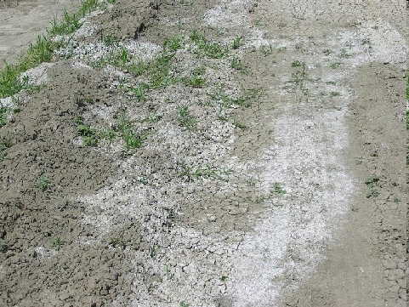

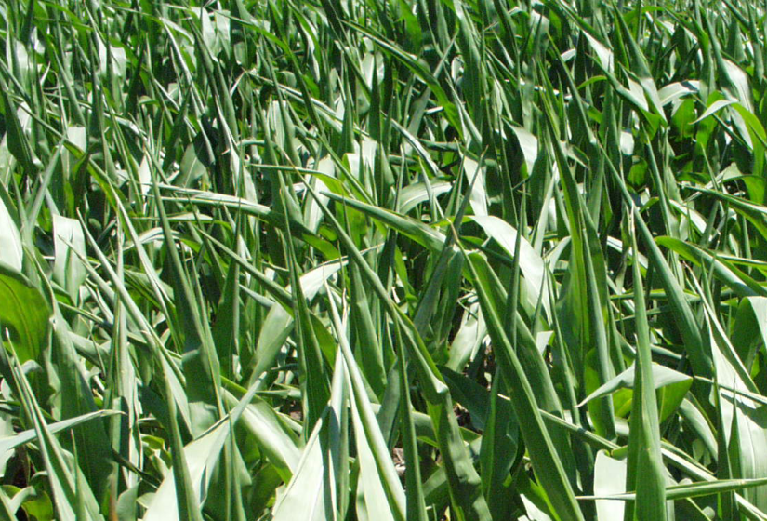
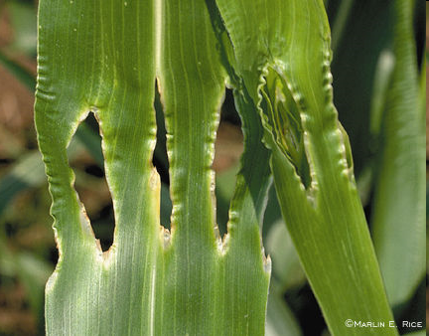
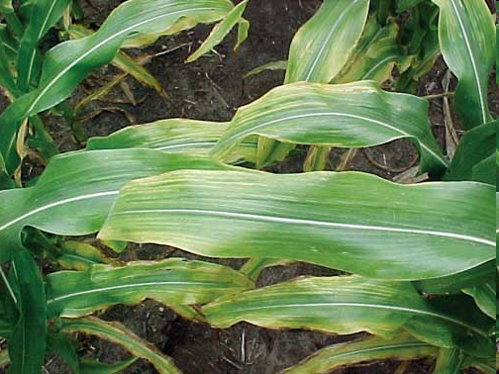

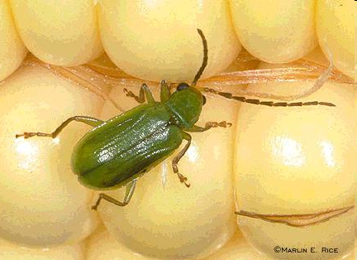
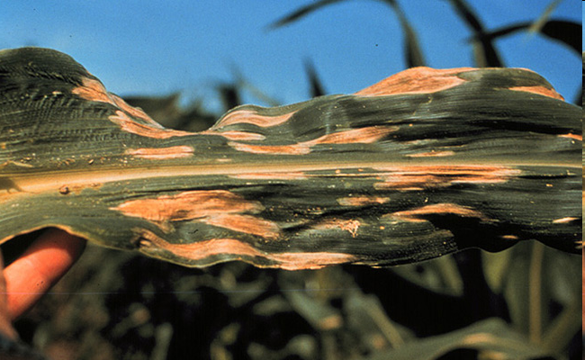


Cold Tolerance
Salt Tolerance
Drying Tolerance
Recovery from Wounding
Antonio P. Mallarino
Nutrient Uptake
Pest Resistance
Fungal Disease Resistance
Photosynthetic Capacity

Slide 43
Implications recommendation
Plant grown in water stress are sensitive to abiotic and biotic stress.
  Nutrient recommendations across landscapes may need modification.
  Plants in water stressed areas may be very sensitive to diseases and insect damage.
Precision recommendations may be needed.

Slide 44
Has drought resistance improved?
Year | SD Palmer Drought Severity | SD Heating degree day | Eastern SD Rainfall | all wheat | Soybean | Corn
 |  | C | cm | kg/ha | kg/ha | kg/ha
1974 | -2.18 | 1091 | 28.2 | 1,234 | 1,341 | 2,065
2012 | -3.35 | 1048 | 28.2 | 3,071 | 2,012 | 6,321
2012-1974 |  |  | 0 | 1,837 | 671 | 4,256

Slide 45
How have we done
(SD from 1974 to 2012)
 | Harvested |  |  | Selling price |  |  | Yields |  |  | Return |  |  | $ return in 2012
Crop | 1974 | 2012 |  | 1974 | 2012 |  | 1974 | 2012 |  | 1974 | 2012 |  | from higher yields
 | ha×1000 | ha×1000 |  | $/Mg | $/Mg |  | Mg/ha | Mg/ha |  | $/ha | $/ha |  | $/ha
Corn | 943 | 2,145 |  | 135 | 277 |  | 2.07 | 6.32 |  | 279 | 1,756 |  | 1,183
Soybean | 149 | 1,906 |  | 269 | 518 |  | 1.34 | 2.01 |  | 363 | 1,046 |  | 347
Wheat | 1,252 | 904 |  | 179 | 302 |  | 1.23 | 3.07 |  | 222 | 930 |  | 556
Total | 2,344 | 4,955

Slide 46
Did tillage and soil health impact yields?
Did soil health improvements impact yield?
Can we separate the soil, genetic, and management factors?

Slide 49
Independent confirmation
Advice, analysis of 88,000 samples from 1992 to 2012
Increase from 3.5 to 4.2 % organic matter over a 20 year period (20% increase).
Between 350 to 400 kg SOC/year, (this rate is almost identical to our rate.
This is the basis for a California Advanced Fuel Standard application.

Slide 50
Impact on plant available water

Slide 51
Calculating improvements in plant available water
SD NASS |  | No-tillage |  |  | Water increase in the surface 15 cm
region | 2004-2007 | 2008-2010 | 2004-2010 |  | No-till | Con. till | SOC | Total
 |  | % adoption |  |  | cm | cm | cm | cm
NC | 97 | 69 | 85 |  | 4.42 | 0.39 | 0.61 | 5.42
C | 68 | 57 | 63 |  | 3.28 | 0.96 | 0.61 | 4.85
NE | 20 | 11 | 16 |  | 0.83 | 2.18 | 0.61 | 3.63
EC | 11 | 5 | 8 |  | 0.42 | 2.39 | 0.61 | 3.42
SE | 29 | 33 | 31 |  | 1.61 | 1.79 | 0.61 | 4.02
NW | 40 | ns | nc |  | 2.08 | 1.56 | 0.61 | 4.25
SC | 88 | ns | nc |  | 4.58 | 0.31 | 0.61 | 5.50
CW | 82 | ns | nc |  | 4.26 | 0.47 | 0.61 | 5.34
Ave. | 54 | 35 | 41 |  |  |  |  | 4.55

Slide 52
Return from reduced tillage and soil health
Region | Water (cm) | $ return due to soil
NC | 5.42 | 314,079,000
C | 4.85 | 192,166,000
NE | 3.63 | 156,307,000
CE | 3.42 | 150,990,000
SE | 4.02 | 174,466,000
NW | 4.25 | 43,869,000
SC | 5.5 | 59,186,000
CW | 5.34 | 337,244,000
Total |  | 1,124,788,000

Slide 53
Soil + genetic impacts, summary
From 1974 to 2012
  maize (+4.3 Mg ha⁻¹), $1,183/ha
  soybean (+0.67 Mg ha⁻¹), $347/ha
  wheat (+1.84 Mg ha⁻¹), $556/ha
Soil management impacts
  22% corn
  61% soybean
  41% wheat

Slide 54
What have we learned
Fields are a mosaic of habitats,
Each organism having unique characteristics that are influenced by,
    Climate
    Soil properties
    Crop yields.
Abiotic and biotic stresses may interact
  Water stress may impact other factors,
The effectiveness of matching solutions to problems rests on the a ability to identify problems, characterize the site, and develop appropriate solutions.

Slide 55
Summary
Genetic and management improvements are providing opportunities for row crop production to expand into marginal soils.
To prevent the implementation of non-sustainable practices on these soils, careful management should be followed.

Slide 56
Summary
We need to integrate molecular biology, and applied agronomy to improve our understanding of agricultural systems.
Technology advances have made it possible to do stuff that was impossible 4 years ago.
Mathematics can be used to convert this information into higher yields and wealth.

Slide 57
Additional questions
Is increasing WUE providing an opportunity to move corn into more marginal lands?
  Range or CRP
  We are currently conducting an careful assessment of land use change.
  Accurate benchmarks are needed.

Slide 58
Can we improve food security and resilience against extreme climatic events by narrowing the yield gap?
Should we convert marginal lands into row crop production?

Slide 64
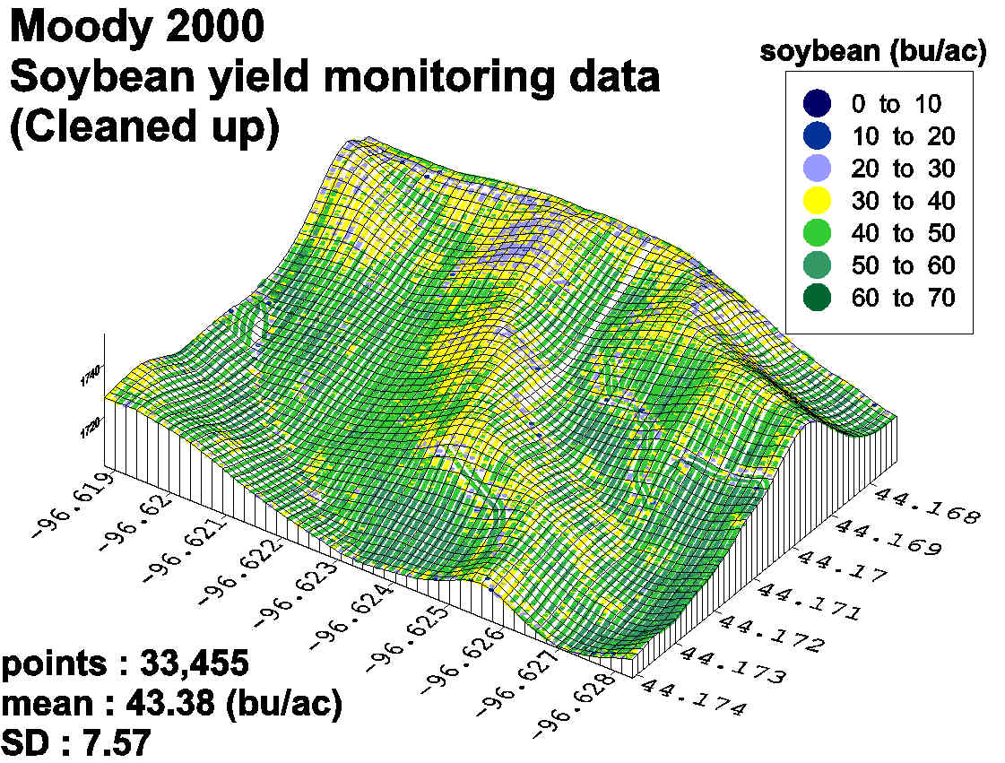
Case study 1: Moody and Brookings fields

Slide 65
Across the nation, numerous projects found very poor relationships between the chemical characteristics and yield.
What does this mean?

Slide 66
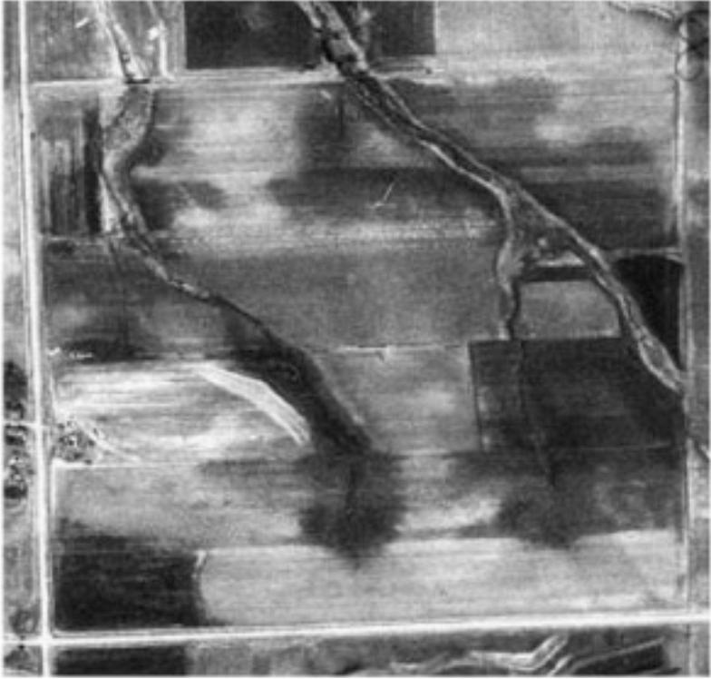
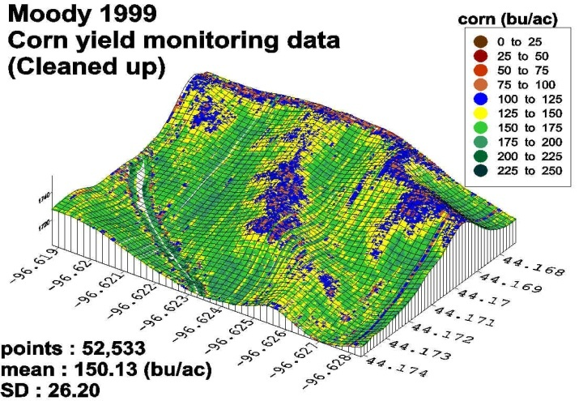
Soil P and yield
Old hay stacks
We did find that historical management impacted current chemical characteristics.

Slide 67
Carbon
Fractionation
C-13 isotopic discrimination can be
used to assess stress.
Stomata
Water
Enriched in ¹³C
CO₂
CO₂
HCO₃
Sugar

Slide 68
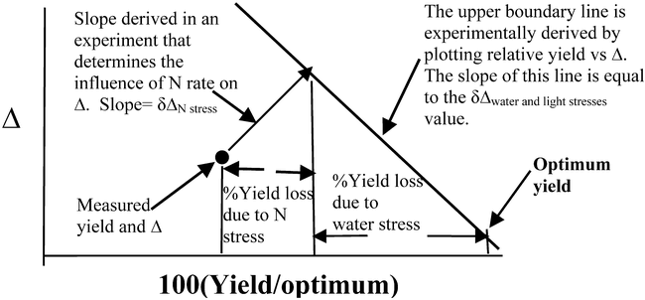
Creating new knowledge through the creation of new tools: isotopic techniques
Yield losses due to water stress
Yield losses due to N stress

Slide 69
Precipitation use efficiency
N rate | PUE (Kg grain/cm water)
0 | 170
56 | 203
112 | 223
168 | 220
p value | <0.001
Lsd _{(0.05)} | 9.33

Slide 70
Yield zone impacted uptake efficiency
Yield environment |  | FUE | Soil N Efficiency (O N)
Natural rainfall |  | 44% | 61%
Nat +irrigation |  | 48% | 67%

Slide 71
Non-harvested plant residues
CO₂
k_{NHC}
k_{SOC}
Soil organic carbon
kSOC • SOCe = kNHC • NHCm
NHCa = NHCa + (NHCm –NHCm)
δSOC/δt = kNHC [NHCa –NHCm]

Slide 72
Organic C additions = m (dDOC) + b
SOC_{i} dt
Organic C
additions
SOC
Fraction that needs to
Be replaced in each
time-step
dSOC
dt
If we accept this equation then, we can use data with different changes in
DOC or Non-harvested biomass to determine the maintenance requirement.

